Slide 1
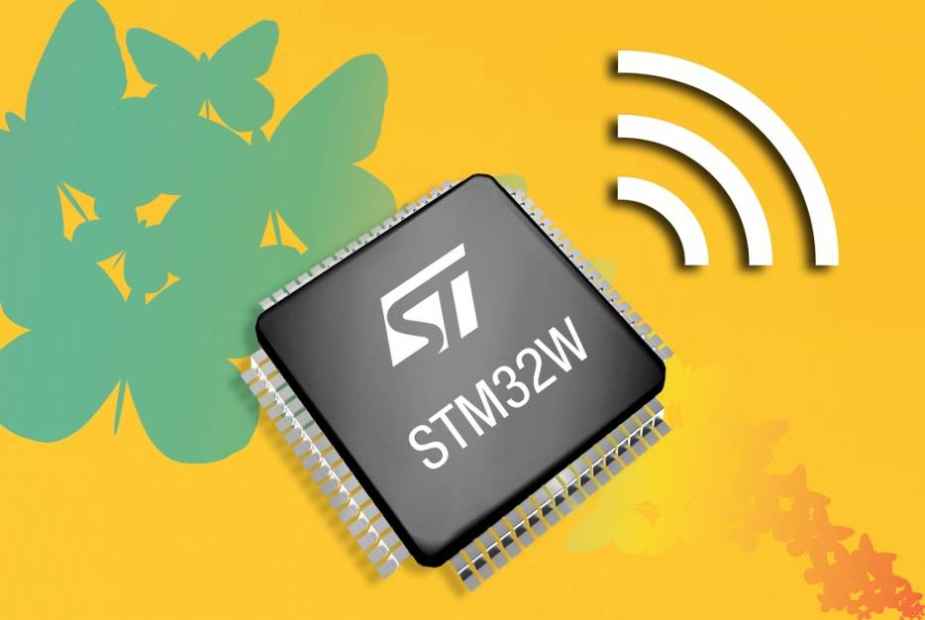

STM32W for RF applications
Embedded world 2010

Slide 2







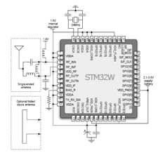

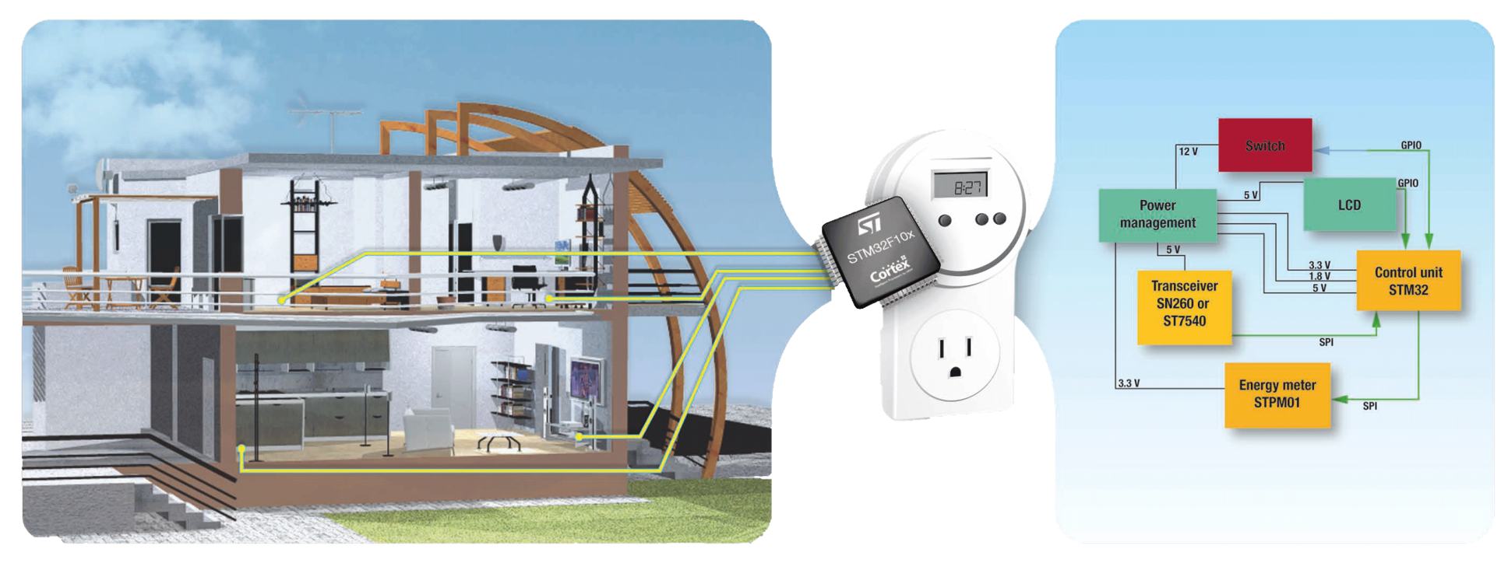
STM32W - IEEE 802.15.4 open platform
Home &
building
automation
Wireless
sensor
network
Consumer
Remote control
Home automation
Smart
energy
Healthcare
Mesh networking / performance /secured Stacks
Star / PtoP networks / Cost optimized
or similar
or similar
MAC
PHY
A complete SOC solution (µC, Radio and FW)

Slide 3

STM32W – IEEE 802.15.4 radio/open platform
IEEE 802.15.4 / 2.4Ghz Radio
  Transmitter: 2-point direct synthesizer modulation
  Receiver: low IF super heterodyne architecture
  Digital BB DSP & MAC support
  -100 dBm sensitivity and up to 7dBm output power
Microcontroller
  ARM Cortex-M3 core architecture
  Embedded memory (eFlash 16kx64, SRAM 4kx16)
Networking
  Zigbee compliant PRO stack w/ some enhancements
  128 Kbytes Flash for stack & apps codes
Peripherals
  AES encryption HW accelerator
  Debug channel via JTAG
  USART, SPI, I2C, 24 GPIOs
Other
  Compatible with SN2xx series
  QFN48 and QFN40 packages available

Slide 4
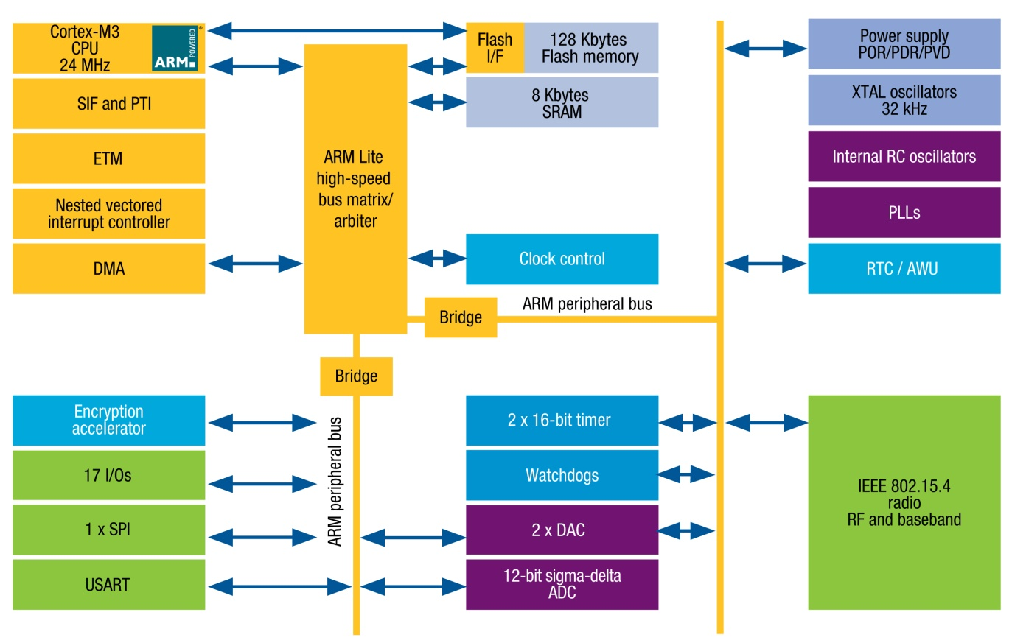
STM32W architecture overview
Fully IEEE 802.15.4 compliant radio
Power management
  Sleep mode <1µA
On-chip debug support
  Packet trace module interface enables remote monitoring of radio messages
Memory protection
  EmberZNet has unrestricted access to all areas of the chip
  The application runs in protected mode
  Stack overflow protection
Encryption acceleration
  Application runs at full speed with strong encryption
DMA improves data throughput
broad range of peripherals
  USART/SPI/I²C/GPIO/ADC

Slide 5
STM32W S/W libraries
Customer code
Customer application
Customer application
Customer application
Libraries provided by ST to customers
Network layer
(optional)
Standard library
RF4CE nwk layer
and CERC profile
Standard library
Silicon
ZigBee PRO stack
(incl. Std periph lib)
15.4 simple MAC
15.4 simple MAC
Application profiles:
- Smart Energy (SE)
Home Automation
(HA)
Consumer (CERC)
STM32W
STM32W
STM32W
Simple MAC application
RF4CE application
ZigBee application

Slide 6
STM32W in a nutshell
Highest performance
  Industry leading RF performance
  Network performance – highest throughput, lowest latency for routing, security computations
  Enhanced battery life by 25%+
Application code space
  ZigBee PRO stack 20%+ smaller than former products generation, plus architecture provides more usable flash
Power Consumption
  1/3rd less active current than 250/260 series, combined with core efficiencies,
  results in longest battery life in industry
Industry standard/leading core
  High performance, standard tools, powerful debug capabilities
  Part of largest ARM Cortex-M3 product family: STM32

Slide 7
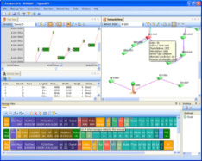
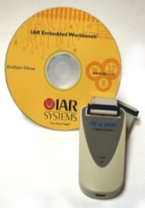
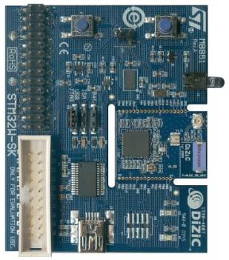


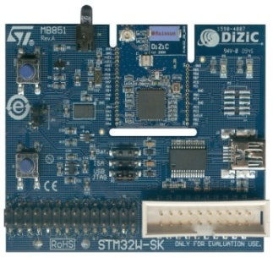
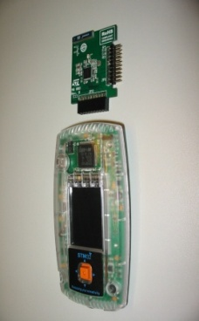

STM32W starter kit
RF application board
Infrared
x4
Network analyzer
RF extension
STLink + IAR compiler
+
x2
Extension
board
+
Primer 2
Analyzer
Primer II
RF extension
RF application
board
Sniffer
USB
RF application board
Extension
kit
Developer kit

Slide 8
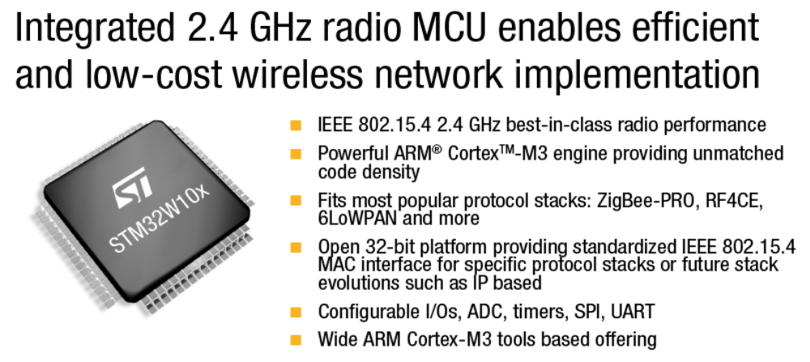

Thank you
Integrated 2.4 GHz radio MCU enables efficient and low-cost wireless network implementation
STM32W is Zigbee certified platform (PRO Stack)
STM32W is ZigBee RF4CE certified platform
STM32W is IEEE 802.15.4 certified platform

